Slide 1
Welcome to BUSM 180 Introduction to Business
February 27, 2023

Slide 2
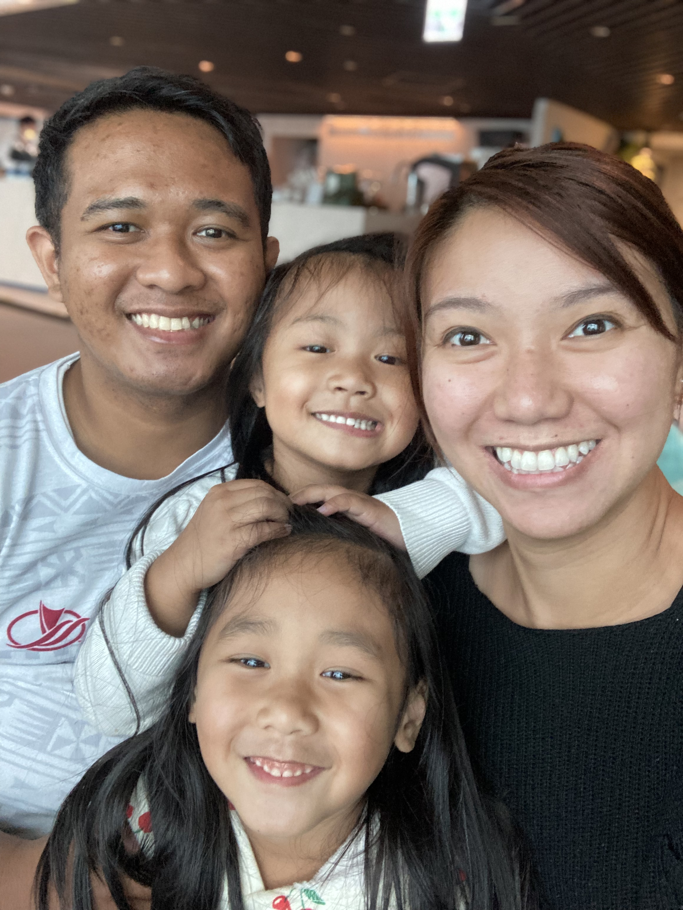
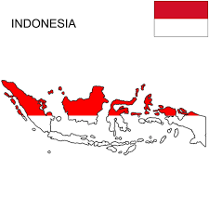
Today’s Instructor
Basic:
Name: Kevin Kusuma
Master: University of Utah
Bachelor: Brigham Young University – Hawaii
Analytics:
Harness the power of data to SOLVE business problems
BUSM 410 (Advanced Analytics & Big Data)
BUSM 461 (Quality Control & Process Improvement)

Slide 3













Slide 4


Introduce Yourself

Slide 5


Slide 6


Slide 7
Case 1
Siolana is a manager of a shoe store located at Kaneohe Shopping Center. The owner has asked her to give him a quick report on sales of the previous week (2/20 – 2/26).

Slide 8
Break Into Groups
Discuss the benefits of Excel for businesses.
Write at least 5 of them on a piece of paper.

Slide 9
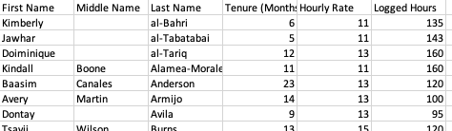
Case 2
Feelin' Brisket is a small restaurant in Dallas, Texas. Felicia recently bought the restaurant which employs several workers including cooks, servers, and bussers. She received the employee list which includes their hourly rate and their logged hours of the previous month. Could you please help Felicia analyze her new restaurant by answering these questions:
How many employees does the restaurant have?
What is the average tenure of the employees?
What is the average hourly rate of all employees?
What are the total logged hours?
What is the total labor cost?

Slide 10
github.com/c-kevin-Kusuma/byuh

Slide 11

Let’s Do A Quick Exercise
https://create.kahoot.it/details/12b747eb-4371-436c-ae50-256504afd3ca

Slide 12
Next Class
To-do List:
Fresh Sushi Excel (Due before next class)
Email me for questions at mulyono@go.byuh.edu
Add me on LinkedId at linkedin.com/in/ckkusuma/

